Slide 1
Теория Информации
В.Н. Ярмолик
Лекция 12
2017

Slide 2
Stream Cipher Cryptosystem
Stream Ciphers
There are two types of stream ciphers - one for which the key-bit stream is independent of the plaintext and the other for which the key-bit stream is a function of either the plaintext or the ciphertext depending on the feedback connection. The former is often called a synchronous cipher because it requires synchronization between the key-bit stream and the ciphertext for successful decipherment. The later is often referred to as a self-synchronizing cipher or auto-key cipher because an erroneously added or deleted bit causes only a fixed number of errors in the deciphered plaintext, after which the correct plaintext is again restored.
Bit-Stream Key Generator
Bit-Stream Key Generator
Plaintext M
K
K
Ciphertext C
Plaintext M
Fig. Stream Cipher

Slide 3
Stream Cipher Cryptosystem
Stream Cipher
Some of the differences between block and stream cipher are:
1.The block cipher enciphers a single data block at one time, but the stream cipher requires to encipher or decipher on a bit-by-bit bases;
2.In the block cipher, every ciphertext bit is a complex function of plaintext and key bits via intersymbol dependence, but in the stream cipher every cipher bit is produced by Exclusive Or operation of the plaintext bit and key bit;
3.The block cipher may not require an initial seed vector, but the stream cipher does;
4.Block cipher like DES used in the commercial sector, but stream ciphers are used for military purposes.

Slide 4
Stream Cipher Cryptosystem
Stream Cipher
The main part of any stream cipher is key generation algorithm. More often used algorithm for various application is Multiplicative Congruent Algorithm
x_{t+1}=(ax_{t}+c) mod N;
Where for Pentium PC is a very popular module
N=2³¹-1=2147483647, and “magic”
values of a are: 16807,630360016, 1078318381, 1203248318, 397204094, 2037812808, 1323257245, 764261123, 112817, ….

Slide 5
Stream Cipher Cryptosystem
Stream Cipher
Pseudorandom Number Generators
1. x_{t+1}=(1176x_{t}+1476x_{t-1}+1776x_{t-2}) mod (2³²-5);
2. x_{t+1}=(2¹³(x_{t}+x_{t-1}+x_{t-2})) mod (2³²-5);
3. x_{t+1}=(1995x_{t}+1998x_{t-1}+2001x_{t-2}) mod (2³²-849);
4. x_{t+1}=(2¹⁹(x_{t}+x_{t-1}+x_{t-2})) mod (2³²-1629);
5. x_{t+1}=(5115x_{t}+1776x_{t-1}+1492x_{t-2}+2111111111x_{t-3}+c_{t}) mod 2³²;
c_{t} =⎣(5115x_{t-1}+1776x_{t-2}+1492x_{t-3}+2111111111x_{t-4}+c_{t-1})/ 2³²⎦ .
6. COMBO: z_{n}=(x_{n}+y_{n} ) mod 2³², x_{n}=(x_{n-1}*x_{n-2} ) mod 2³², y_{n}=(y_{n-1}+c_{n} ) mod 2¹⁶, c_{n}= ⎣(y_{n-1}+c_{n-1} ) /2¹⁶⎦.
7. KISS: z_{n}=(x_{n}+y_{n}+u_{n}) mod 2³², x_{n}=(69069x_{n-1}+1 ) mod 2³², y_{n}=y_{n-1}(I₃₂ +L¹³)(I₃₂ +R¹⁷) (I₃₂ +L⁵), u_{n}=(2u_{n-1}+u_{n-2}+c_{n}) mod 2³², c_{n}= ⎣(2u_{n-2}+u_{n-3} +c_{n-1} ) / mod 2³²⎦.

Slide 6
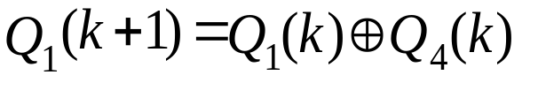
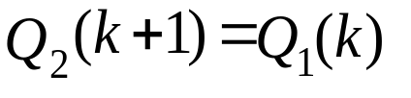
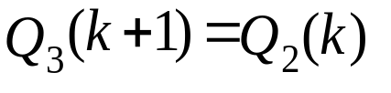
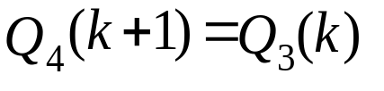
Stream Cipher Cryptosystem
LFSR-Linear Feedback Shift Register
A linear feedback shift register (LFSR) is often used as the cryptographic key encoder for a stream cipher system. One of the main reason for this is that LFSR is easily obtainable and comparatively inexpensive. The encoder that generates the key-bit stream must be deterministic so that the key-bit stream may be reproduced for decipherment According to the primitive polynomial ϕ(x)=1+x+x⁴ the following block diagram of the LFSR can be design
Q₁
Q₂
Q₃
Q₄
D
D
D
D
Clk
Clk
Clk
Clk
Cp
M2
Fig. LFSR for the generating polynomial φ(x)=1+x+x⁴

Slide 7
Stream Cipher Cryptosystem
LFSR-Linear Feedback Shift Register
State sequence for LFSR
State | Q₁Q₂Q₃Q₄ | State | Q₁Q₂Q₃Q₄
0 1 2 3 4 5 6 7 | 1 0 0 0 1 1 0 0 1 1 1 0 1 1 1 1 0 1 1 1 1 0 1 1 0 1 0 1 1 0 1 0 | 8 9 10 11 12 13 14 15 | 1 1 0 1 0 1 1 0 0 0 1 1 1 0 0 1 0 1 0 0 0 0 1 0 0 0 0 1 1 0 0 0

Slide 8
Stream Cipher Cryptosystem
LFSR-Linear Feedback Shift Register
One primitive polynomial for each m from 1 to 28
m=degϕ(x) | ϕ(x) | m=degϕ(x) | ϕ(x)
1 2 3 4 5 6 7 8 9 10 11 12 13 14 | 1+x 1+x+x² 1+x+x³ 1+x+x⁴ 1+x²+x⁵ 1+x+x⁶ 1+x+x⁷ 1+x+x⁵+x⁶+x⁸ 1+x⁴+x⁹ 1+x³+x¹⁰ 1+x²+x¹¹ 1+x³+x⁴+x⁷+x¹² 1+x+x³+x⁴+x¹³ 1+x+x¹¹+x¹²+x¹⁴ | 15 16 17 18 19 20 21 22 23 24 25 26 27 28 | 1+x+x¹⁵ 1+x²+x³+x⁵+x¹⁶ 1+x³+x¹⁷ 1+x⁷+x¹⁸ 1+x+x²+x⁵+x¹⁹ 1+x³+x²⁰ 1+x²+x²¹ 1+x+x²² 1+x⁵+x²³ 1+x³+x⁴+x⁹+x²⁴ 1+x³+x²⁵ 1+x+x²+x⁶+x²⁶ 1+x+x²+x⁵+x²⁷ 1+x³+x²⁸

Slide 9
Stream Cipher Cryptosystem
LFSR-Linear Feedback Shift Register
ϕ(x)=α₀+α₁x+α₂x²+…+α_{m-1}x^{m-1} +α_{m}x^{m}; α_{m}=α₀=1; α_{i}∈{0,1}
D
D
D
D
D
Clk
Clk
Clk
Clk
Clk
Cp
...
α₀=1
α₁
α₂
α₃
α_{m-1}
α_{m}=1
Standard form of LFSR Type 1
D
D
D
D
Clk
Clk
Clk
Clk
Cp
...
α_{m} =1
α_{m-1}
α_{m-2}
α_{m-3}
α₁
α₀ =1
Standard form of LFSR Type 2

Slide 10
Stream Cipher Cryptosystem
LFSR-Linear Feedback Shift Register
Example ϕ(x)=1+x+x³
D
D
D
D
D
D
Clk
Clk
Clk
Clk
Clk
Clk
Cp
Cp
1 0 0 1 1 0 1 1 1 0 1 1 1 0 1 0 1 0 0 0 1
1 0 0 0 1 0 0 0 1 1 0 1 1 1 1 1 1 0 0 1 1

Slide 11
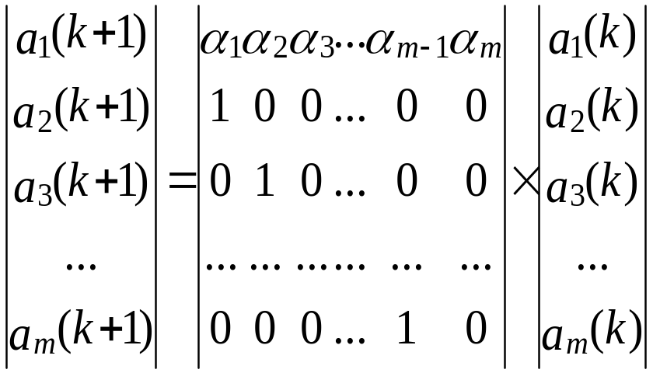

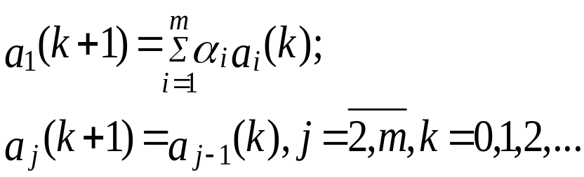
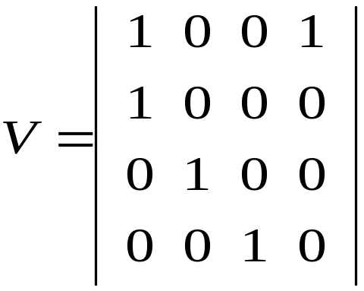
Stream Cipher Cryptosystem
LFSR-Linear Feedback Shift Register
Mathematical description of LFSR
Example
Q₁
Q₂
Q₃
Q₄
D
D
D
D
Clk
Clk
Clk
Clk
Cp
M2

Slide 12
Stream Cipher Cryptosystem
LFSR-Linear Feedback Shift Register
Properties of pseudorandom sequences (M-sequences)
1. There are Φ(2^{m}-1)/m primitive polynomial for a given m, where Φ is a Euler function.
2. For a given polynomial ϕ(x) there is an inverse polynomial which can be derived
according to the following relation ϕ ⁻¹(x)=x^{m}ϕ(x⁻¹).
3. The period L of a M-sequence depends on of the primitive polynomial degree only
L=2^{m}-1.
4. For the specified polynomial ϕ(x) there are L distinct M-sequences that are differ by phase shifts. Thus 15 M-sequences are associated with the polynomial ϕ(x)=1+x+x⁴.

Slide 13
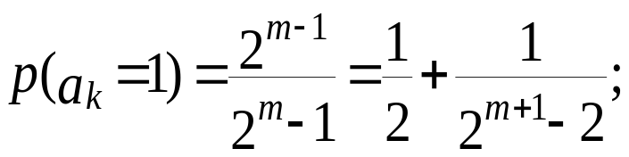
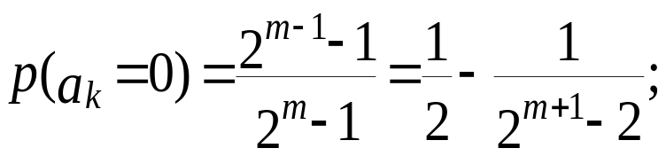
Stream Cipher Cryptosystem
LFSR-Linear Feedback Shift Register
5. In M-sequence there is unpredictable (pseudorandom) sequence of ones and zeros.
Their probabilities is given by

Slide 14
Stream Cipher Cryptosystem
LFSR-Linear Feedback Shift Register
6. There is one run of m (consecutive) 1’s and one run of m-1 0’s. For m-1>r>0, there
are 2^{m-(r+2)} runs of length r for 1’s and the same number of runs of 0’s. For the M-sequence 000111101011001 generated according to the polynomial ϕ(x)=1+x+x⁴ there are one run of 4 1’s one run of 3 0’s, one run each of 2 0’s or 1’s.
7. There is the autocorrelation property that measures the similarity between original M-sequence and a shifted version of the same sequence. Any pair of such sequence will be identical in 2^{m-1}-1 positions and will differ in 2^{m}-1 positions.
000111101011001
011110101100100

Slide 15
Stream Cipher Cryptosystem
LFSR-Linear Feedback Shift Register
8. ‘Shift-and-add’ property. For any s (1≤s<L) there are exist an r ≠s (1≤r<L) such that {a_{k}}⊕{a_{k-s}}= {a_{k-r}}.
{a₀} | 000111101011001
{a₋₂} | 011110101100100
{a₋₉} | 011001000111101

Slide 16
Stream Cipher Cryptosystem
LFSR-Linear Feedback Shift Register
9. Among the L M-sequences generated by the polynomial ϕ(x) there exists a single sequence with the property a_{k}=a_{2k} , k=0,1,2,… which is called characteristic and derived as follows. For the specified polynomial the system of linear equations
a_{i}=a_{2i}; i=0 to m-1;
As an example, we shall fined characteristic sequence for the generating polynomial ϕ(x)=1+x³+x⁴. For this case the system of linear equations takes the form
        a₀=a₀
        a₁=a₂
        a₂=a₄=a₀⊕ a₁
        a₃=a₆=a₂⊕ a₃
The solution is a₁a₂a₃a₄=1000.

Slide 17
Stream Cipher Cryptosystem
LFSR-Linear Feedback Shift Register
10. Property of ‘Decimation’. Decimation of the M-sequence {a_{i}} by q, (q=1,2,3,…) means the generation of another sequence {b_{j}} as qth elements of original M-sequence {a_{i}}, i.e. b_{j}=a_{qj}.
With (L,q)=1 the period of {b_{j}} is 2^{m}-1, and decimation is said to be proper or normal.
0 0 0 1 1 1 1 0 1 0 1 1 0 0 1
0 0 1 1 1 1 0 1 0 1 1 0 0 1 0

Slide 18
Stream Cipher Cryptosystem
NFSR - NonLinear Feedback Shift Registers
A general feedback shift register (FSR) of length m consists of m stages (or delay elements). During each unit of time the following operations are performed: (i) the contents of stage 0 is output and forms part of the output sequence; (ii) the contents of stage j is moved to stage j-1 for each j, 1≤j≤m-1; (iii) the new content of stage m-1 is the feedback bit a_{j}=f(a_{j-1},a_{j-2},a_{j-3},…,a_{j-m+1},a_{j-m}), where the feedback function f is a Boolean function and a_{j-r} is the previous content of the shift register.
Not that if the feedback function f is a linear function, then the FSR is an LFSR, otherwise the FSR is called a nonlinear FSR.
f(a_{j-1},a_{j-2},a_{j-3},…,a_{j-m+1},a_{j-m})
m-1
m-2
1
0
Output
Example. De Bruin sequence for the case of m=3 and nonlinear feedback function f(x₁,x₂,x₃)=1⊕x₂⊕ x₃⊕ x₁ x₂.The output sequence is the de Bruijn sequence with cycle 0,0,0,1,1,1,0,1

Slide 19
Stream Cipher Cryptosystem
NFSR - NonLinear Feedback Shift Registers
Converting a maximum-length generator (LFSR) to the de Bruin Generator
Let we have a LFSR of length m with (linear) feedback function a_{j}=f(a_{j-1},a_{j-2},a_{j-3},…,a_{j-m+1},a_{j-m}), then FSR with feedback function g(a_{j-1},a_{j-2}, a_{j-3},…,a_{j-m+1},a_{j-m})=f(a_{j-1},a_{j-2},a_{j-3},…,a_{j-m+1},a_{j-m})⊕ a*_{j-1}a*_{j-2}a*_{j-3}…a*_{j-m+1} is a de Bruijn FSR. Here a*_{j-1} denotes the complement of a_{j-1}.
Statement 1. For any M-sequence there is only one m-bit code 000…01, where m = deg φ(x) and φ(x) is the primitive polynomial.
Statement 2. For any M-sequence there is the sequence of m-bit codes 000…01, 100…00, where m = deg φ(x).
Statement 3. For any M-sequence there is the only one m-bit code with m-1 first zero, namely the code 000…01.

Slide 20
Stream Cipher Cryptosystem
NFSR - NonLinear Feedback Shift Registers
Example. De Bruin sequence for the case of m=3 and linear feedback function described by primitive polynomial ϕ(x)=1⊕x¹⊕ x⁴, has a nonlinear function
g(a₁,a₂,a₃,a₄)=a₁⊕ a₄⊕ a*₁ a*₂ a*₃.
a₃ | a₂ | a₁ | a₀
1 | 0 | 0 | 0
1 | 1 | 0 | 0
1 | 1 | 1 | 0
1 | 1 | 1 | 1
0 | 1 | 1 | 1
1 | 0 | 1 | 1
0 | 1 | 0 | 1
1 | 0 | 1 | 0
1 | 1 | 0 | 1
0 | 1 | 1 | 0
0 | 0 | 1 | 1
⊕
a_{j-1}
a_{j-2}
a_{j-3}
a_{j-4}
1 | 0 | 0 | 1
0 | 1 | 0 | 0
0 | 0 | 1 | 0
0 | 0 | 0 | 1
0 | 0 | 0 | 0
1 | 0 | 0 | 0
⊕
&

Slide 21
Stream Cipher Cryptosystem
NFSR - NonLinear Feedback Shift Registers
Ford sequence
Ford sequences are a special class of de Bruijn sequences and due to the simplest algorithm for generation can be applied for bit stream generation.
Algorithm: A successive m-bit code X_{k}=(b₂,b₃,b₄,…,b_{m+1}) is generated on the basis of the preceding code X_{k-1}=(b₁,b₂,b₃,…,b_{m}), where the value of b_{m+1}∈{0,1} is determined as follows.
1. The code of the form X’_{k-1}=(b₂,b₃,b₄,…,b_{m},1) is generated.
2. All its cyclic shifts are obtained.
3. Among which code X”_{k-1}=(b_{i},b_{i+1},b_{i+2},…,b_{m},1,b₂,b₃,…,b_{i-1}), which is the largest m-bit number is chosen.
4. If b₂=b₃=…=b_{i-1}=0, then b_{m+1}=b₁⊕ 1, otherwise b_{m+1}= b₁.

Slide 22
Stream Cipher Cryptosystem
NFSR - NonLinear Feedback Shift Registers
Example. Ford sequence for the case of m=4
k | X_{k-1} | X”_{k-1} | b_{m+1}
1 | 0000 | 1000 | b₁⊕ 1=0 ⊕ 1=1
2 | 0001 | 1100 | b₁⊕ 1=0 ⊕ 1=1
3 | 0011 | 1110 | b₁⊕ 1=0 ⊕ 1=1
4 | 0111 | 1111 | b₁⊕ 1=0 ⊕ 1=1
5 | 1111 | 1111 | b₁⊕ 1=1⊕ 1=0
6 | 1110 | 1110 | b₁=1
7 | 1101 | 1110 | b₁=1
8 | 1011 | 1110 | b₁⊕ 1=1⊕ 1=0
9 | 0110 | 1110 | b₁=0
10 | 1100 | 1100 | b₁=1
11 | 1001 | 1100 | b₁⊕ 1=1⊕ 1=0
12 | 0010 | 1010 | b₁⊕ 1=0 ⊕ 1=1
13 | 0101 | 1110 | b₁=0
14 | 1010 | 1010 | b₁⊕ 1=1⊕ 1=0
15 | 0100 | 1100 | b₁=0
16 | 1000 | 1000 | b₁⊕ 1=1⊕ 1=0

Slide 23
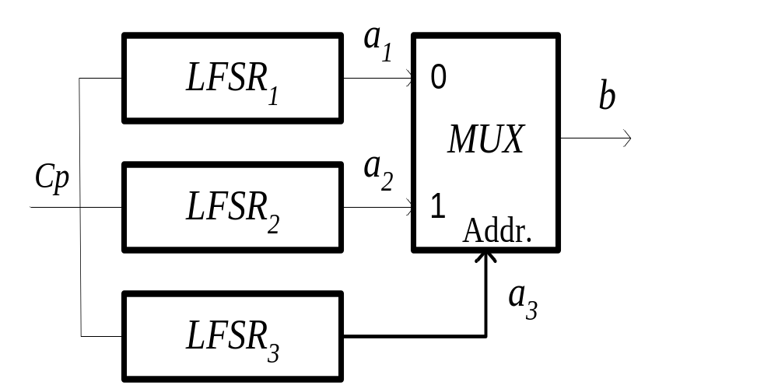
Stream Cipher Cryptosystem
NFSR - NonLinear Feedback Shift Registers
Geffe generator
The Geffe generator, as well as Stop and Go generator is defined by three maximum length LFSRs whose length m1, m2 and m3 are pair wise relatively prime, and the key stream length is (2^{m1}-1)(2^{m2}-1)(2^{m3}-1).
b=(a₂a₃)+ (a₁(1⊕a₃)),

Slide 24
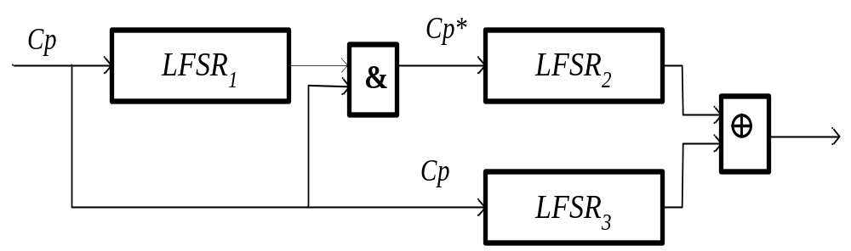
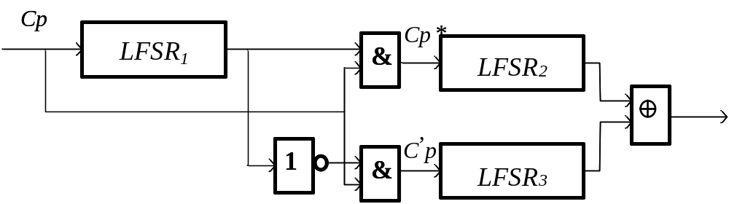
Stream Cipher Cryptosystem
NFSR - NonLinear Feedback Shift Registers
Stop & Go generator
Bеth-Piper Stop-and-Go generator

Slide 25
Stream Cipher Cryptosystem
NFSR - NonLinear Feedback Shift Registers
Gollmann Cascaded Key stream generator
1
LFSR 1
M2
&
LFSR 2
M2
&
LFSR 3
M2
Clk
Clk
Clk
The Goldman Cascaded Key stream generator generates the sequence with the length is (2^{m1}-1)(2^{m2}-1)(2^{m3}-1).

Slide 26
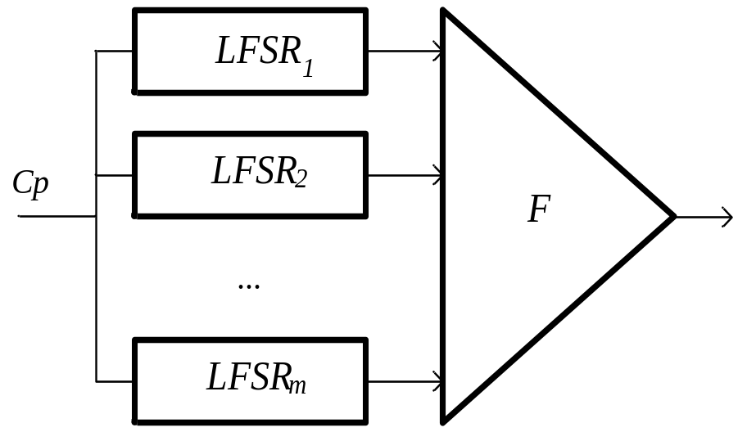
Stream Cipher Cryptosystem
NFSR - NonLinear Feedback Shift Registers
Threshold generator

Slide 27
Stream Cipher Cryptosystem
A5/1 Algorithm
A5/1 is a stream cipher used to provide over-the-air communication privacy in the GSM cellular telephone standard. It was initially kept secret, but became public knowledge through leaks and reverse engineering.
A GSM transmission is organised as sequences of bursts. In a typical channel and in one direction, one burst is sent every 4.615 milliseconds and contains 114 bits available for information. A5/1 is used to produce for each burst a 114 bit sequence of keystream which is XORed with the 114 bits prior to modulation. A5/1 is initialized using a 64-bit key together with a publicly-known 22-bit frame number.
A5/1 is based around a combination of three Linear Feedback Shift Registers (LFSRs) with irregular clocking. The three shift registers are specified as follows:

Slide 28
Stream Cipher Cryptosystem
A5/1 Algorithm
LFSR number | Length in bits | Feedback polynomial | Clocking bit | Tapped bits
1 | 19 | x¹⁹ + x¹⁸ + x¹⁷ + x¹⁴ + 1 | 9 | 14, 17, 18, 19
2 | 22 | x²² + x²¹ + 1 | 11 | 21, 22
3 | 23 | x²³ + x²² + x²¹ + x⁸ + 1 | 11 | 8, 21, 22, 23
The registers are clocked in a stop/go fashion using a majority rule. Each register has an associated clocking bit. At each cycle, the clocking bit of all three registers is examined and the majority bit is determined. A register is clocked if the clocking bit agrees with the majority bit. Hence at each step two or three registers are clocked, and each register stops with probability 3/4.

Slide 29
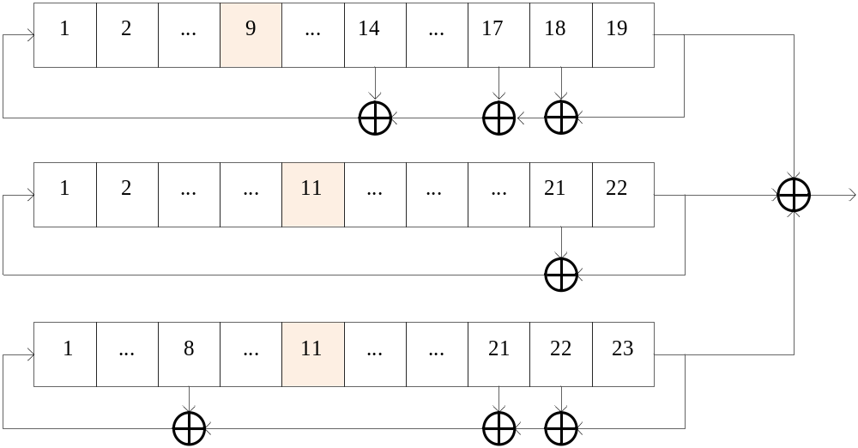
Stream Cipher Cryptosystem
A5/1 Algorithm

Slide 30
Stream Cipher Cryptosystem
Synchronous Stream Cipher
Synchronous Stream Cipher can be implemented based on LFSR according to the following block diagram.
K₀
K₀
LFSR
LFSR
K
K
M
C=M⊕K
M
K₀ – Seed Vector; M – Plaintext; C – Ciphertext.

Slide 31
Stream Cipher Cryptosystem
Synchronous Stream Cipher
Example.
0
0
1
0
0
0
1
0
K₀ = 0010
K
K
M
C
M
M=101011111100001
K=011110101100100
C=110101010000101

Slide 32
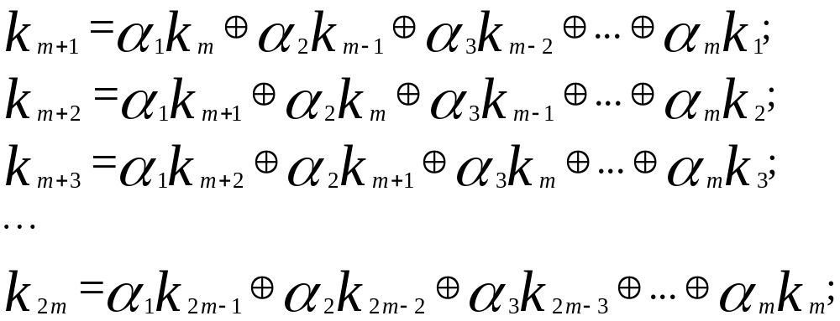
Stream Cipher Cryptosystem
Synchronous Stream Cipher
However, the LFSR is not always suitable for key generation because an opponent can easily derive the entire key stream from 2m bits of plaintext-ciphertext pairs.

Slide 33
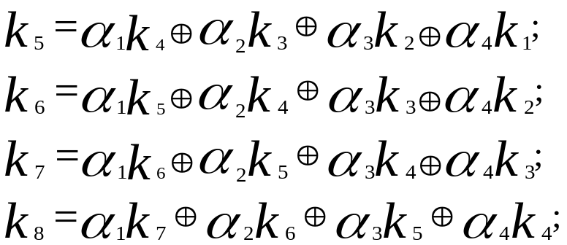
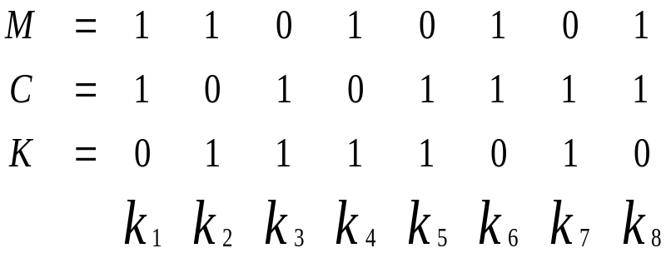
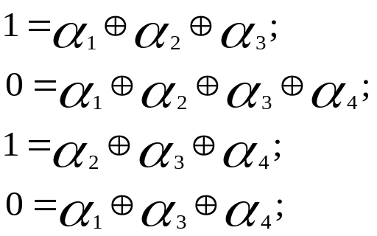

Stream Cipher Cryptosystem
Synchronous Stream Cipher
Example.To brake stream cryptosystem shown on previous example first of all the pair of 8 bit plaintext-ciphertext have to be obtained. Let it be M=10101111 and C=11010101. Then, the modulo two summation of this M an C will result as a key stream K.

Slide 34
Stream Cipher Cryptosystem
Synchronous Stream Cipher
To increase efficiency of the cryptosystem the combined approach can be used. As an example see below the combination of stream cipher and DES algorithm.
m=64
m=64
LFSR
LFSR
Z
Z
DES
DES
K
K
M
C=M⊕K
M

Slide 35
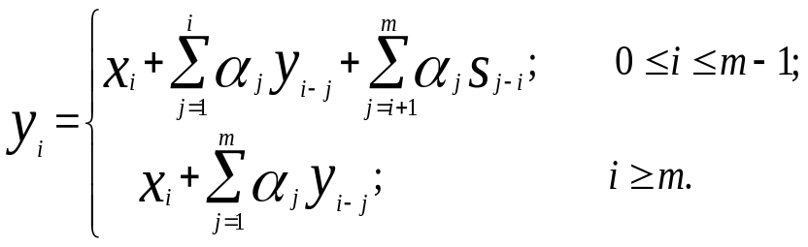
Stream Cipher Cryptosystem
Self-Synchronizing Stream Cipher
Self-synchronizing cipher systems are another class of stream cipher and are categorized as ciphertext autokey cipher and plaintext autokey cipher.
Ciphertext Autokey Cipher
Z
α₀
α₁
α₂
α₃
α_{m-2}
α_{m-1}
α_{m}
…
y_{i-1}
y₁₋₂
y_{i-3}
y_{i-m+1}
y_{i-m}
X
Y
s₁
s₂
s₃
s_{m-1}
s_{m}
ϕ(x)=α₀+α₁x+α₂x²+…+α_{m-1}x^{m-1} +α_{m}x^{m}; α_{m}=α₀=1; α_{i}∈{0,1}; Z-key stream; X plaintext; Y-ciphertext; S-seed vector.

Slide 36

6. Stream Cipher Cryptosystem
6.4. Self-Synchronizing Stream Cipher
Ciphertext Autokey Decipher
α₁
α₂
α₃
α_{m-2}
α_{m-1}
α_{m}
…
y_{i-1}
y₁₋₂
y_{i-3}
y_{i-m+1}
y_{i-m}
Y
Z
s₁
s₂
s₃
s_{m-1}
s_{m}
ϕ(x)=α₀+α₁x+α₂x²+…+α_{m-1}x^{m-1} +α_{m}x^{m}; α_{m}=α₀=1; α_{i}∈{0,1};
Z-key stream; X plaintext; Y-ciphertext; S-seed vector.
X

Slide 37
Stream Cipher Cryptosystem
Self-Synchronizing Stream Cipher
Example. ϕ(x)=1+x+x⁴; X=11101001; S=(s₁s₂s₃s₄)=0011.
Ciphertext Autokey Cipher
Z
X
0
0
1
1
Y
1 | 0 | 0 | 0 | 0 | 1
1 | 0 | 0 | 0 | 0 | 0
1 | 1 | 1 | 0 | 0 | 0
0 | 1 | 1 | 1 | 0 | 0
1 | 0 | 0 | 1 | 1 | 0
0 | 0 | 0 | 0 | 1 | 1
0 | 1 | 1 | 0 | 0 | 1
1 | 1 | 1 | 1 | 0 | 0

Slide 38
6. Stream Cipher Cryptosystem
6.4. Self-Synchronizing Stream Cipher
Example 6.5. Continuation. ϕ(x)=1+x+x⁴; Y=00110011; S=(s₁s₂s₃s₄)=0011.
Ciphertext Autokey Decipher
Y
0
0
1
1
Z
X
0 | 0 | 0 | 1 | 1 | 1
0 | 0 | 0 | 0 | 1 | 1
1 | 0 | 0 | 0 | 0 | 1
1 | 1 | 0 | 0 | 0 | 0
0 | 1 | 1 | 0 | 0 | 1
0 | 0 | 1 | 1 | 0 | 0
1 | 0 | 0 | 1 | 1 | 0
1 | 1 | 0 | 0 | 1 | 1

Slide 39
6. Stream Cipher Cryptosystem
6.4. Self-Synchronizing Stream Cipher
Plaintext autokey cipher are often called self-synchronizing cipher with plaintext input to the shift register. Let consider an example of such a type of the cryptosystem for polynomial ϕ(x)=1+x+x⁴
X
y_{i-1}
y_{i-2}
y_{i-3}
y_{i-4}
Z
Y
A self-synchronizing encipher with plaintext excitation.
Z
Y
y_{i-1}
y_{i-2}
y_{i-3}
y_{i-4}
X
A autokey decipher system with plaintext feedback.

Slide 40
Stream Cipher
RC4
Description of RC4
This stream cipher was invented in 1987 by Ron Rivest, one of the inventors of the RSA public key cryptography algorithm.
Even though the RC4 cipher is officially named "Rivest Cipher 4", it is also known as "Ron's Code 4" (RC2, RC5 and RC6 also exist).
RC4 had a really large success thanks to its simplicity and efficiency. It was used in many popular standards and protocols such as WEP, WPA, SSL or TLS.
The RС4 is used with a variable length cryptographic key (session key), typically between 40 and 256 bits

Slide 41
Stream Cipher
RC4
Principle
The RC4 algorithm generates a pseudo-random key stream that is then used to generate the ciphertext (by XORing it with the plaintext). It is called pseudo-random because it generates a sequence of numbers that only approximates the properties of random numbers. The sequence of bytes generated is not random since the output is always the same for a given input but it has to approximate random properties to make it harder to crack. The key stream is generated from a variable length key using an internal state composed of the following elements:
1. A 256 bytes array (denoted S) containing a permutation of these 256 bytes
2. Two indexes i and j, used to point elements in the S array.
Once the S array has been initialized and "shuffled" with the key-scheduling algorithm (KSA), it is used and modified in the pseudo-random generation algorithm (PRGA) to generate the key stream.

Slide 42
Stream Cipher
RC4
Key-scheduling algorithm (KSA)
The first step of this algorithm consist in initializing the S table with the identity permutation: the values in the array are equal to their index.
Once the S array is initialized, the next step consist in shuffling the array using the key to make it a permutation array. To do so, we simply iterate 256 times the following actions after initializing i and j to 0:
1. Compute j = [j + S[i] + key[i mod keylength] ] mod 256
2. Swap S[i] and S[j]
3. Increment i
S
0
1
2
…
254
255
0 1 2 … 254 255

Slide 43
Stream Cipher
RC4
Key-scheduling algorithm (KSA)
Step n
i and j already computed
0 1 2 i j 254 255
…
…
…
S
S[i]
S[j]
0 1 2 i j 254 255
…
…
…
S
S[j]
S[i]

Slide 44
Stream Cipher
RC4
Key-scheduling algorithm (KSA)
0 1 2 i j 254 255
s
…
…
…
S[i]
S[j]
Step n+1
i = i + 1
j = [j + S[i] + key[i mod keylength]] mod 256
0 1 2 i mod keylength keylength -1
…
…
…
…
Key
0 1 2 i j 254 255
s
…
…
…
S[i]
S[j]

Slide 45
Stream Cipher
RC4
Key-scheduling algorithm (KSA)
Here is some pseudo-code corresponding to the key-scheduling algorithm (KSA):
for i from 0 to 255
S[i] := i
end for
j := 0
for i from 0 to 255
j := [j + S[i] + key[i mod keylength]] mod 256
swap values of S[i] and S[j]
end for

Slide 46
Stream Cipher
RC4
The pseudo-random generation algorithm (PRGA)
This step of the algorithm consists in generating a key stream of the size of the message to encrypt. This algorithm enables us to generate a key stream of
any size. To do so, we first initialize the two indexes (i, j) to 0 and we then start the generation of the key stream one byte at a time until we reached the size of the message to encrypt. For each new byte to compute we do the following actions:
1. Compute new value of i and j:
i := (i + 1) mod 256
j := (j + S[i]) mod 256
2. Swap S[i] and S[j] to have a dynamic state (it makes it obviously harder to crack than if the state was computed only once and use for the generation of the whole key stream)
3. Retrieve the next byte of the keystream from the S array at the index
(S[i]+S[j]) mod 256

Slide 47
Stream Cipher
RC4
The pseudo-random generation algorithm (PRGA)
Here is some pseudo-code corresponding to the pseudo-random generation
algorithm:
i := 0
j := 0
while Generating Output:
i := (i + 1) mod 256
j := (j + S[i]) mod 256
swap values of S[i] and S[j]
K := S[(S[i] + S[j]) mod 256]
Output K
end while
S
0
1
2
…
…
S[i]
…
S[j]
0 1 2 … … i … j … 254 255
Key stream byte
(S[i] + S[j]) mod 256

Slide 48
Stream Cipher
RC4
The pseudo-random generation algorithm (PRGA)
This step of the algorithm consists in generating a key stream of the size of the message to encrypt. This algorithm enables us to generate a key stream of
any size. To do so, we first initialize the two indexes (i, j) to 0 and we then start the generation of the key stream one byte at a time until we reached the size of the message to encrypt. For each new byte to compute we do the following actions:
1. Compute new value of i and j:
i := (i + 1) mod 256
j := (j + S[i]) mod 256
2. Swap S[i] and S[j] to have a dynamic state (it makes it obviously harder to crack than if the state was computed only once and use for the generation of the whole key stream)
3. Retrieve the next byte of the keystream from the S array at the index
(S[i]+S[j]) mod 256

Slide 49
Stream Cipher
RC4
The pseudo-random generation algorithm (PRGA)
Here is some pseudo-code corresponding to the pseudo-random generation
algorithm:
i := 0
j := 0
while Generating Output:
i := (i + 1) mod 256
j := (j + S[i]) mod 256
swap values of S[i] and S[j]
K := S[(S[i] + S[j]) mod 256]
Output K
end while
S
0
1
2
…
…
S[i]
…
S[j]
0 1 2 … … i … j … 254 255
Key stream byte
(S[i] + S[j]) mod 256

Slide 50
Stream Cipher
RC4
Encryption and decryption
Once the key stream has been generated, the encryption of the plaintext is really simple: it simply consists of a XOR between the plaintext and the key stream. See below an illustration of the encryption:
Plaintext
…
0 1 2 … plaintext
length-1
⊕
Key stream
…
0 1 2 … plaintext
length-1
=
Ciphertext
…
0 1 2 … plaintext
length-1

